Slide 1
Key Exposure Problem of Chameleon Hashing
********
12-4-2024

Slide 2
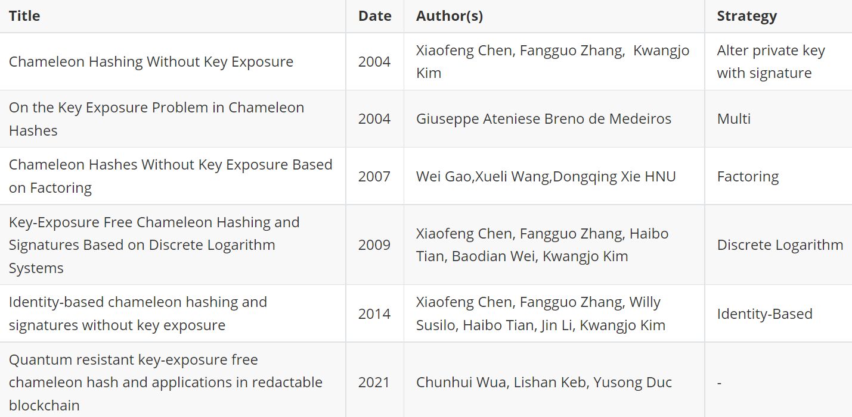
Literature Review

Slide 3
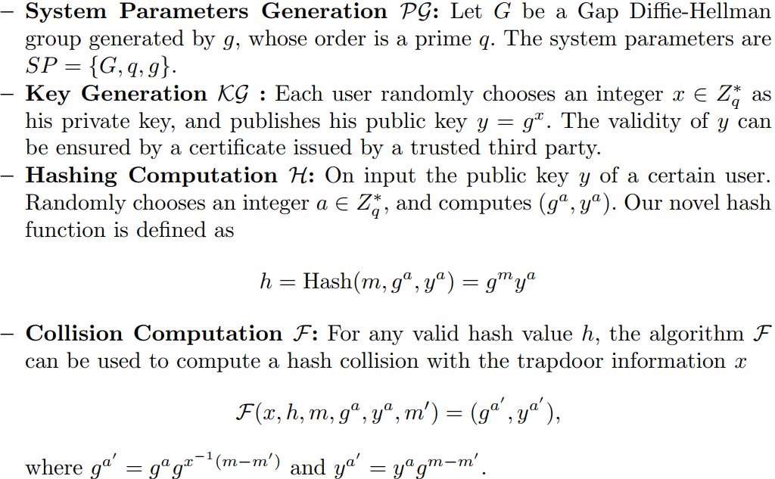
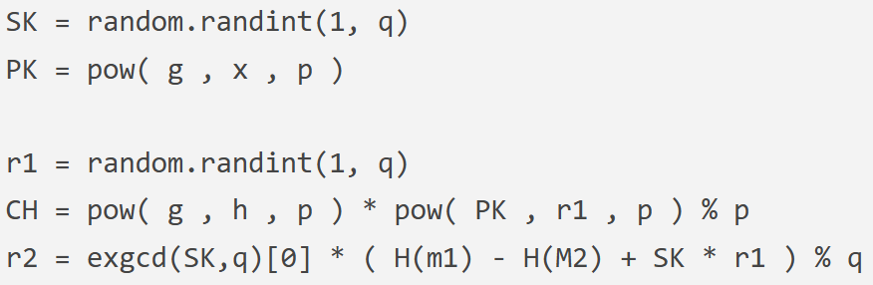
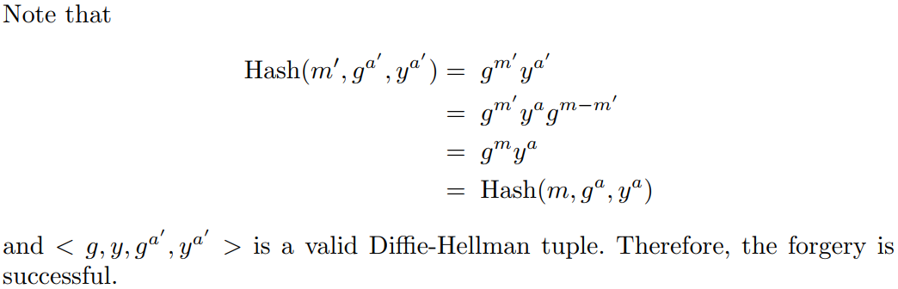
The Initial Scheme
The secret key is easy to obtain
Weak non-transferability
Weak non-repudiation
Simplified code
——Chameleon Hashing and Signatures
Hugo Krawczyk,Tal Rabin 1997

Slide 4
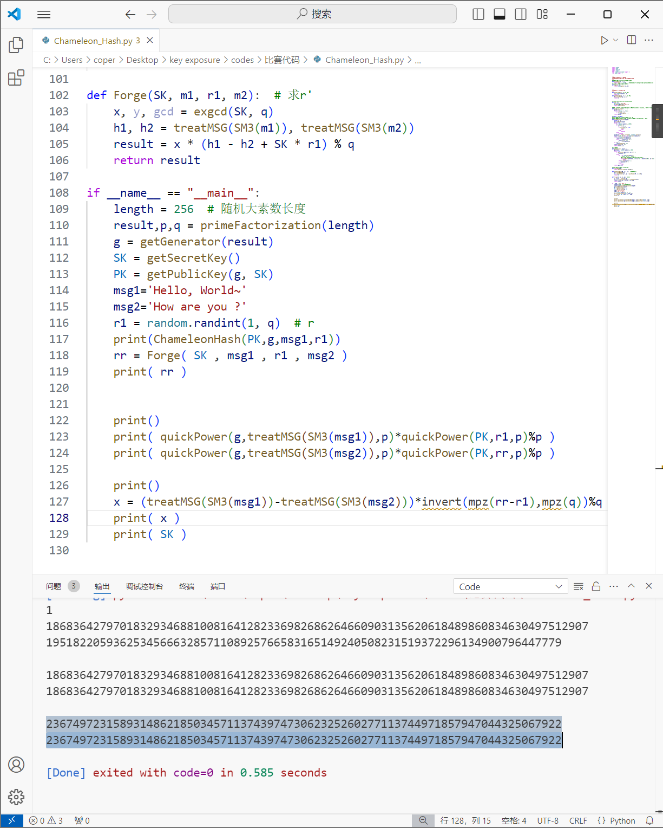
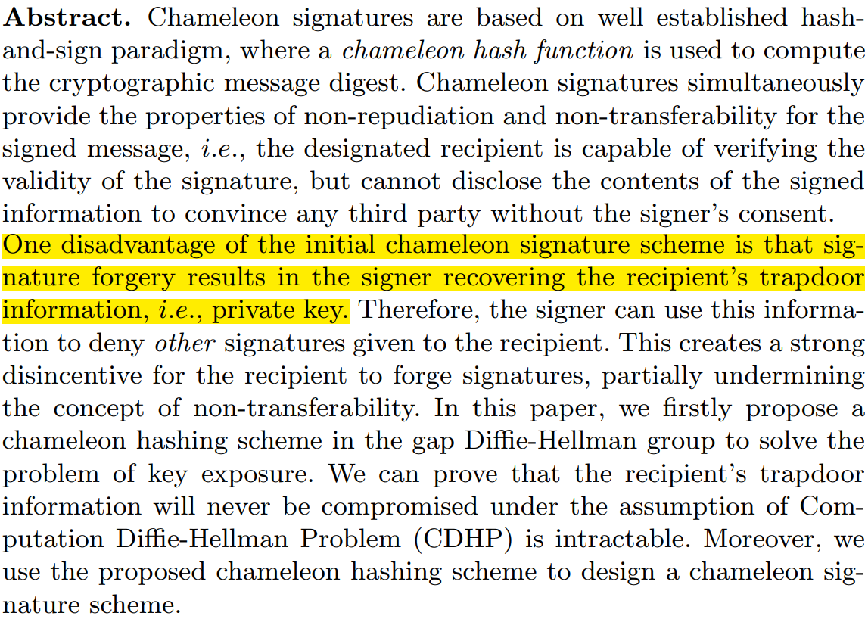
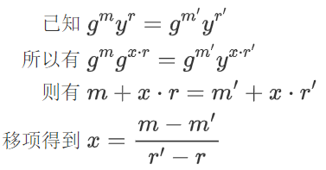
Motivation
——Chameleon Hashing without Key Exposure
Xiaofeng Chen
——On the Key Exposure Problem in Chameleon Hashes
Giuseppe Ateniese

Slide 5
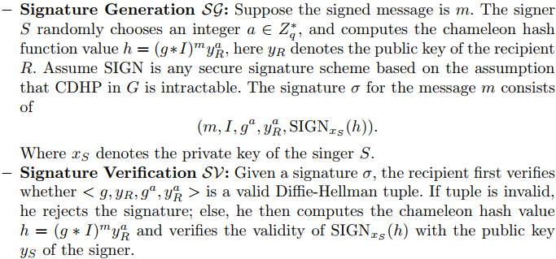
1. Alter private key with signature
Without key exposure
Provide non-repudiation and tamper-proofing
Source: Xiaofeng Chen, Fangguo Zhang, Kwangjo Kim: Chameleon Hashing Without Key Exposure. Information Security.2004.87-98

Slide 6
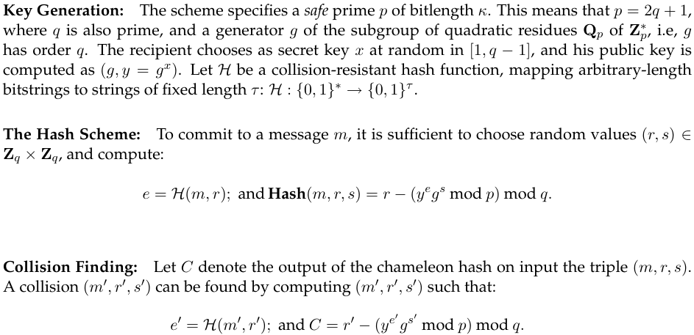
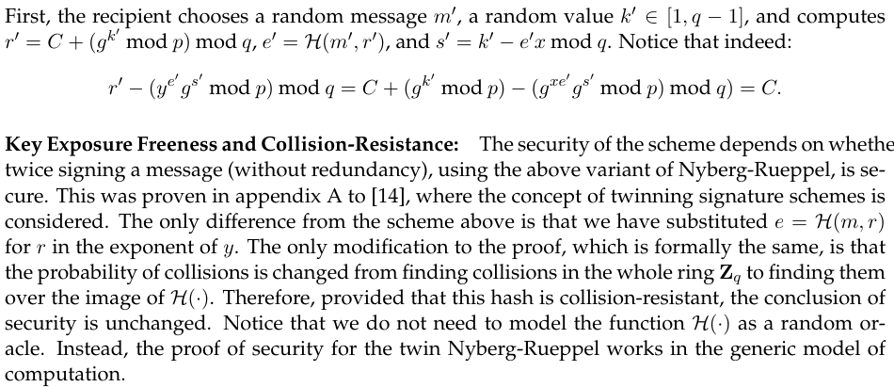
2. Two Strategies
2.1. Single Trapdoor
(Without Message Hiding)
Security Dependency:
whether it is safe to sign the same message twice without redundancy
Different:
place r in the exponent of y with e=H(m,r).
Source: Giuseppe Ateniese, Breno de Medeiros: On the Key Exposure Problem in Chameleon Hashes. Security in Communication Networks.2004.165-197

Slide 7

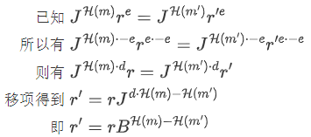
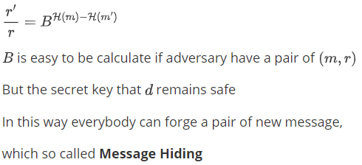
2. Two Strategies
2.2. Double Trapdoors (With Message Hiding)-Based on RSA
Source: Giuseppe Ateniese, Breno de Medeiros: On the Key Exposure Problem in Chameleon Hashes. Security in Communication Networks.2004.165-197

Slide 8
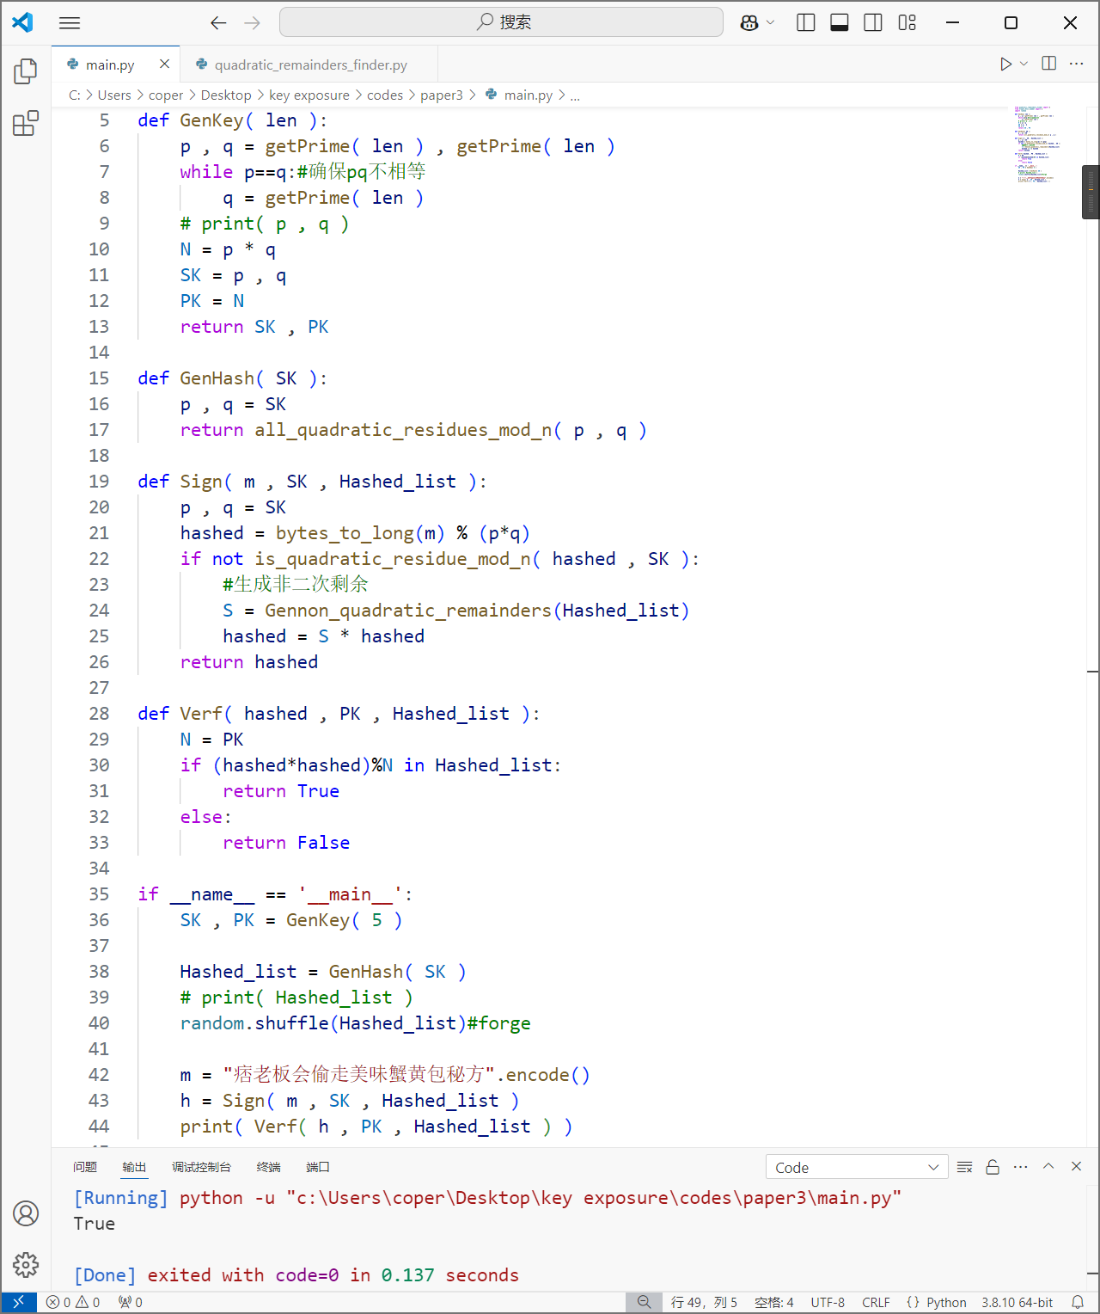
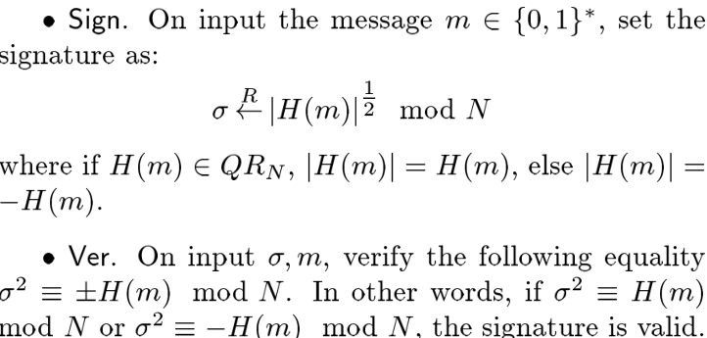
3. Based on Factoring
3.1. Signature Scheme
If one know the secret key (p,q), Quadratic and non-quadratic remainders is computable by CRT, or it’s a hard problem.
Source: Wei Gao, Xue-Li Wang, Dong-Qing Xie: Chameleon Hashes Without Key Exposure Based on Factoring. Journal of Computer Science and Technology.2007.109-113

Slide 9
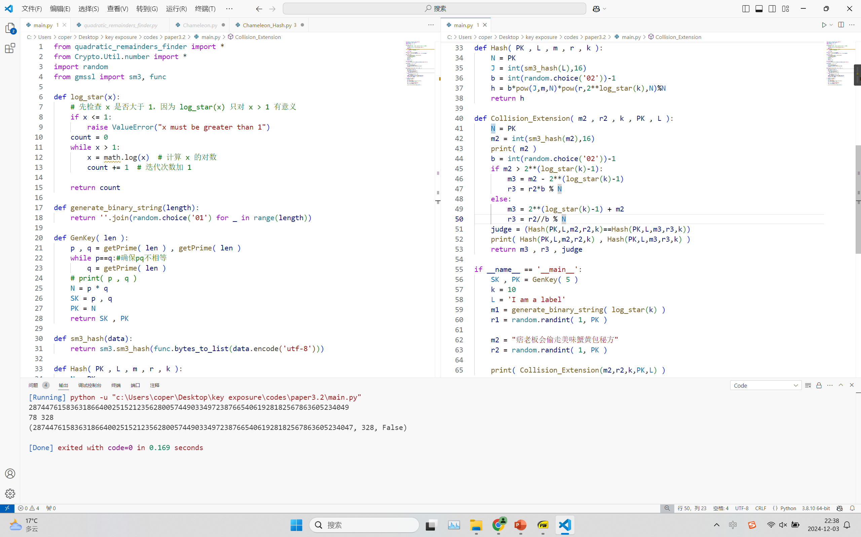
3. Based on Factoring
3.2. Chameleon Hash
暂未跑通实验代码
有待后续继续研究
Source: Wei Gao, Xue-Li Wang, Dong-Qing Xie: Chameleon Hashes Without Key Exposure Based on Factoring. Journal of Computer Science and Technology.2007.109-113

Slide 10
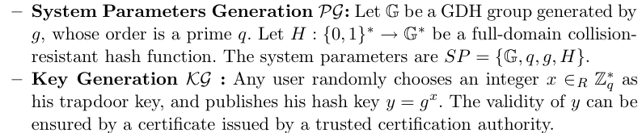
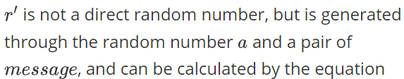
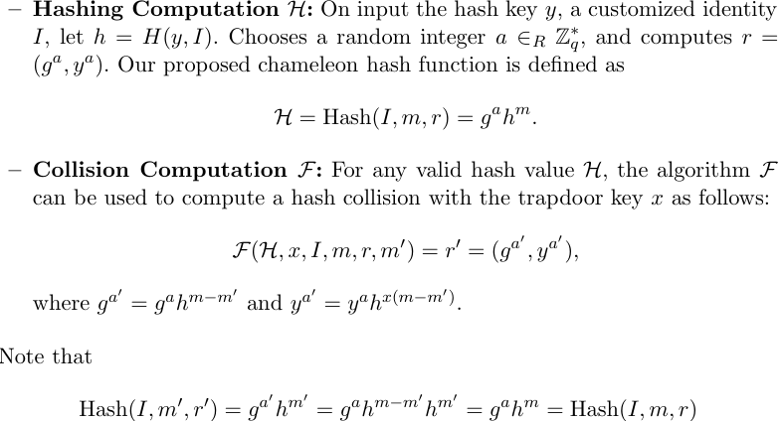

4. Discrete Logarithm
Source: Xiaofeng Chen, Fangguo Zhang, Haibo Tian, Baodian Wei, Kwangjo Kim: Key-Exposure Free Chameleon Hashing and Signatures Based on Discrete Logarithm Systems.2009

Slide 11
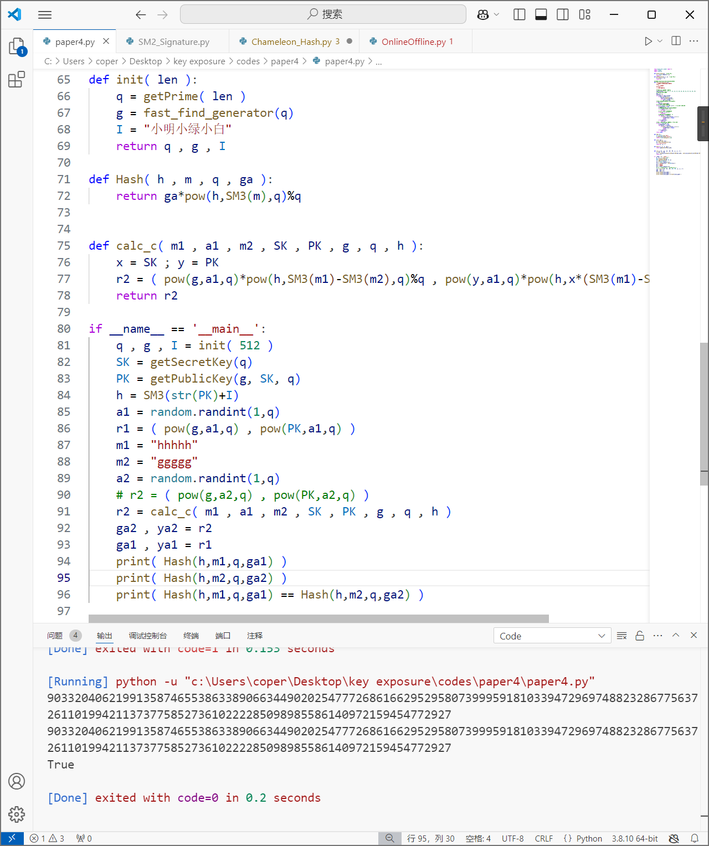
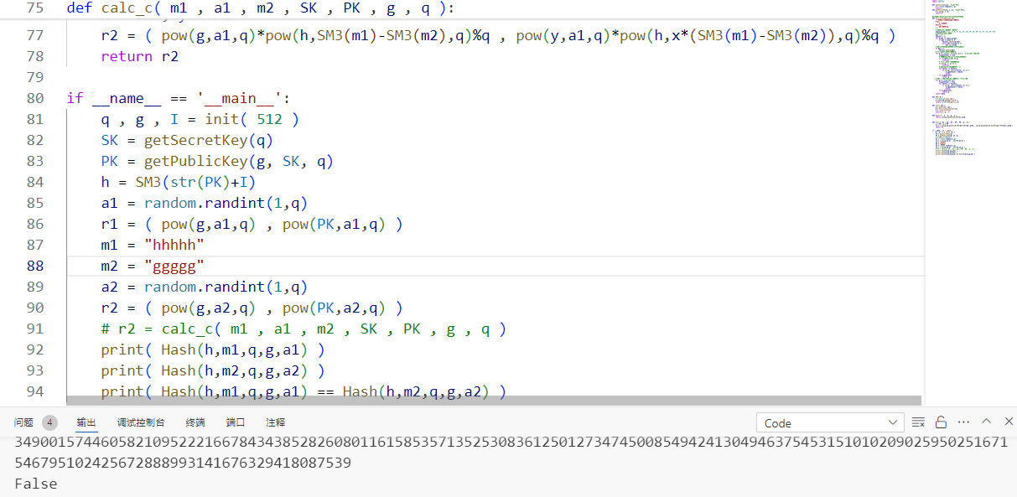
4. Discrete Logarithm
——Simulation
最一开始按照论文逻辑写代码，一直跑不通
后来注意到a’是不可计算的，换了种写法就通了
Source: Xiaofeng Chen, Fangguo Zhang, Haibo Tian, Baodian Wei, Kwangjo Kim: Key-Exposure Free Chameleon Hashing and Signatures Based on Discrete Logarithm Systems.2009

Slide 12
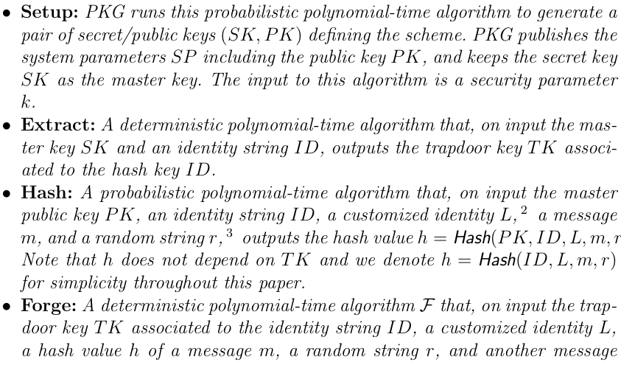
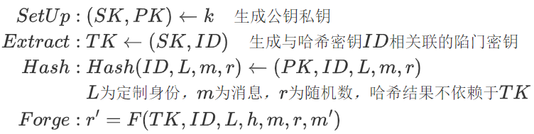
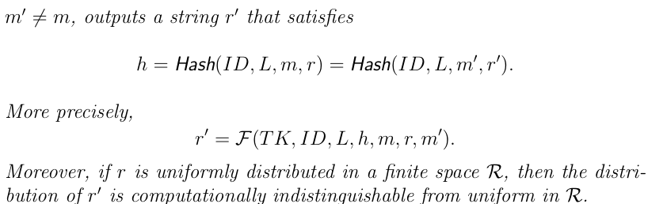
5. ID-Based
Even if the hash function construction is not strong enough, it is only possible to leak ID. The hash result does not depend on TK, so there is no key leakage.
Source: Xiaofeng Chen, Fangguo Zhang, Willy Susilo, Haibo Tian, Jin Li, Kwangjo Kim: Identity-based chameleon hashing and signatures without key exposure. Information Security and Privacy.2009.200–215

Slide 13
6. Quantum Resistant
后量子的，比较难懂，还没看完（悲）
Source: Chunhui Wu, Lishan Ke, Yusong Du: Quantum resistant key-exposure free chameleon hash and applications in redactable blockchain. Information Sciences.2021.438-449

Slide 14
7. Summary and Outlook
3.2的实验代码
第六篇再花时间读一下，实在读不懂就搁置一下
Survey的密钥泄露部分可以开写了
第二篇的第一个理论是否存在连分数攻击的安全风险

